Slide 1
Unity Week 2
Building games in 2D

Slide 2
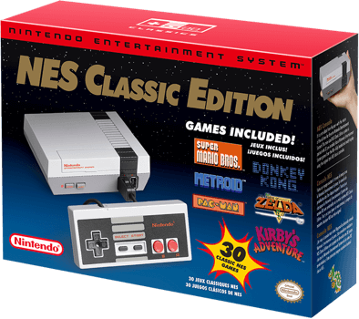
The year of Retro gaming

Slide 3
Hyper Light Drifter

Slide 5
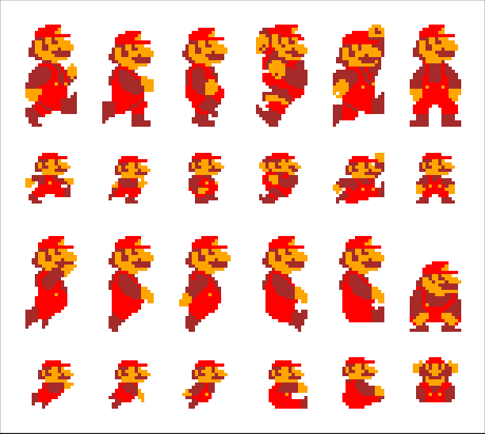
Sprites?

Slide 6
In early video gaming, hardware sprites were a method of compositing separate bitmaps so that they appear to be part of a single image on a screen.

Slide 8
State Machine

Slide 9
The idea is that a character is engaged in some particular kind of action at any given time. The actions available will depend on the type of gameplay but typical actions include things like idling, walking, running, jumping, etc.

Slide 10
These actions are referred to as states, in the sense that the character is in a “state” where it is walking, idling or whatever.

Slide 11
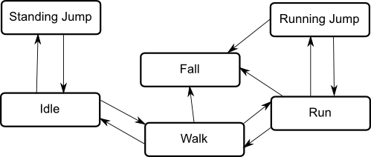
The character will have restrictions on the next state it can go to rather than being able to switch immediately from any state to any other.

Slide 12
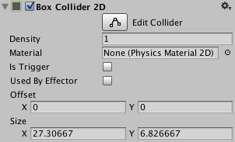
Collider2D
A Collider 2D component is used to define the physical shape of an object in the scene and can participate in 2D collisions and trigger events.

Slide 13
Is Trigger?
Use collider as a Trigger (also known as a Trigger Zone), in order to detect when an object is within a particular space in the game world.

Slide 14
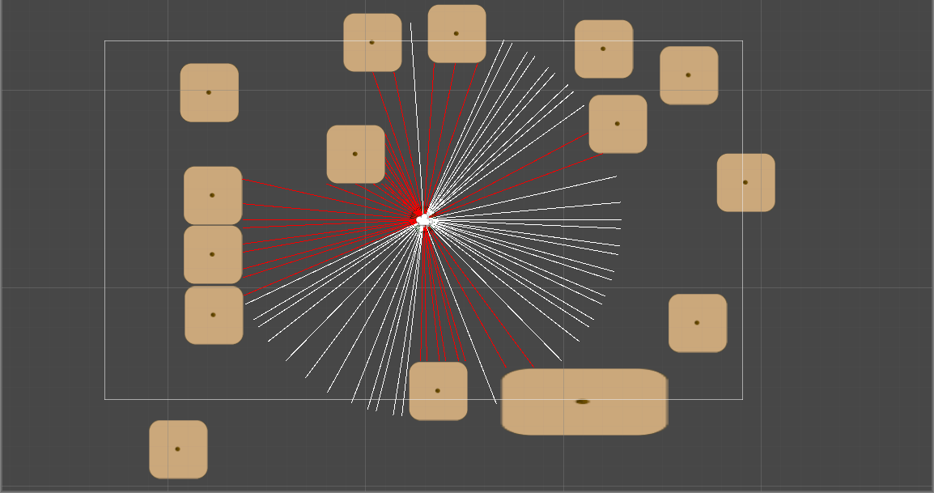
Raycast 2D
Notes:
A raycast is conceptually like a laser beam that is fired from a point in space along a particular direction. Any object making contact with the beam can be detected and reported.

Slide 16
Let’s create a Pacman game in Unity!
https://noobtuts.com/unity/2d-pacman-game
Notes:
Instructions for this code can be found at https://noobtuts.com/unity/2d-pacman-game

